Slide 1
Unit-6
Recursion

Slide 2
Recursion
Recursion is the process which comes into existence when a function calls a copy of itself to work on a smaller problem. Any function which calls itself is called recursive function, and such function calls are called recursive calls. Recursion involves several numbers of recursive calls. However, it is important to impose a termination condition of recursion.

Slide 3
Example of recursion to calculate factorial of a number
#include <stdio.h>
int fact (int);
int main()
{
int n,f;
printf("Enter the number whose factorial you want to calculate?");
scanf("%d",&n);
f = fact(n);
printf("factorial = %d",f);
}
int fact(int n)
{
if (n==0)
{
return 0;
}
else if ( n == 1)
{
return 1;
}
else
{
return n*fact(n-1);
}
}

Slide 4
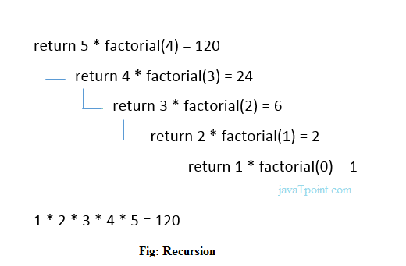
Output:
Enter the number whose factorial you want to calculate? 5
factorial = 120
We can understand the above program of the recursive method call by the figure given below:

Slide 5
Recursive Function
A recursive function performs the tasks by dividing it into the subtasks. There is a termination condition defined in the function which is satisfied by some specific subtask. After this, the recursion stops and the final result is returned from the function.
The case at which the function doesn't recur is called the base case whereas the instances where the function keeps calling itself to perform a subtask, is called the recursive case.

Slide 6
Pseudocode for writing any recursive function is given below.
if (test_for_base)
{
return some_value;
}
else if (test_for_another_base)
{
return some_another_value;
}
else
{
// Statements;
recursive call;
}

Slide 7
Example to find the nth term of fibonacci series
Fibonacci series is:
Whose 1st term is 0
Second term is 1
Next term is the sum of previous two terms i.e.
Third term is = First term + Second term i.e.
0+1=1
Next term(4th term )= Second term + Third term i.e.
1+1=2
And so on upto nth term.

Slide 8
Code to find nth term of fibonacci series
#include<stdio.h>
int fibonacci(int);
void main ()
{
int n,f;
printf("Enter the value of n?");
scanf("%d",&n);
f = fibonacci(n);
printf("%d",f);
}
int fibonacci (int n)
{
if (n==0)
{
return 0;
}
else if (n == 1)
{
return 1;
}
else
{
return fibonacci(n-1)+fibonacci(n-2);
}
}

Slide 9
Output:
Enter the value of n? 12
144
0+1+1+2+3+5+8+13+21+34+55+89 144

